Slide 1
Topic 2: Part I Fundamental Graphics Programming 【See Chap.7 in the textbook】

Slide 2
Objectives
To understand the meaning of the terms interface, package, abstraction, implementer, and client as they apply to libraries.
To recognize that interfaces are represented in C using header files.
To be able to read the graphics.h interface, which provides access to a library for drawing simple pictures on the screen, and to understand the conceptual abstraction used by the graphics library.
To learn how to draw lines using Movepen and DrawLine and to draw arcs using DrawArc.
To learn how to extend the basic capabilities of the graphics library by defining new higher-level functions.
To practice writing large programs using the graphics package.

Slide 3
Interface
a common boundary between two distinct entities
In programming, interface is the boundary between the implementation of a library and programs that use that library.
Implementer vs client
For each function in the library, the client must know the following:
Name
Arguments
Return type

Slide 4
Interface

Slide 5
Header Files
In C, an interface is traditionally represented by a header file, like stdio.h and string.h
Each of these header files specifies the interface to the underlying library.
To use a library, or say to use functions in a library, the header file of that library has to be included in the source file.
The purpose for the header file here, is to tell the compiler the prototype of the functions you are going to use in the source file.

Slide 6
The Graphics Library
Incorporating a graphical window into a program usually makes life more difficult for the programmer.
The graphics library provided here is a small example of library that serves as an interface to the underlying mechanism of the Windows platform.
It provides very basic functions to draw simple shapes on a window.
It comes with both header file and the source file.
It does not matter what the form of that library is, either in .lib or .c.

Slide 7
The Underlying Model
In a graphical desktop system like MS Windows, it is not possible that your program controls all the pixels on the screen.
More likely, you have to apply for a certain area to show your contents – the window.
Although the window in MS Windows is a set of pixels, it is treated as a piece of paper, with virtual coordinates, different from the native Windows one.
Because it is designed to be as general as possible, and this generality makes it difficult to describe precisely how the graphical display will be presented on any given system.

Slide 8
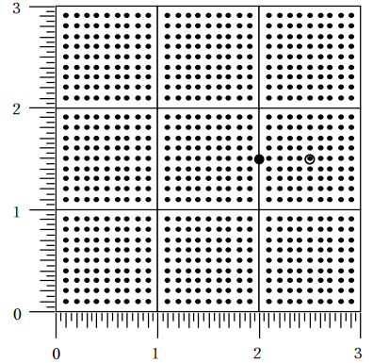
The Coordinates

Slide 9
The Functions
InitGraphics() | Initializes the graphics package, open the window for rendering
MovePen(x, y) | Moves the pen to an absolute position
DrawLine(dx, dy) | Draws a line from current position to a relative coordinates
DrawArc(r, start, sweep) | Draws an arc specified by a radius and two angles
GetWindowWidth() | Returns the width of the graphics window
GetWindowHeight() | Returns the height of the graphics window
GetCurrentX() | Returns the current x-coordinate of the pen
GetCurrentY() | Returns the current y-coordinate of the pen

Slide 10
Initializing the package
The library is written to use Win32API, a set of C function that MS Windows provides to manipulate the operating system, including the screen.
In Win32API, the first function to be called in your C program is WinMain(), but main().
It might be a little bit difficult for you to understand the whole mechanism of WinMain(), so a WinMain() has been implemented in graphics.c.
That WinMain() will do the initialization thing first, and call a function named “Main()”, which is to be your “main()” function. NOTICE the capital letter.
Inside that Main(), InitGraphics() has to be called.

Slide 11
The Pen
The idea here is that there is this virtual pen inside the window.
And this pen has a current position which could be alerted by:
MovePen(x, y);
The x and y here is an absolute coordinate in the window.
After this function, the pen is at (x,y)
And all other drawing function will start at this place.

Slide 12
The Line
To draw a line, use:
DrawLine(dx, dy);
It draws a line from the current position of the pen (x,y) to another position (x+dx, y+dy)
And further more, it brings the pen to the new position
So to draw a square:
MovePen(0.5, 0.5);
DrawLine(0.0, 1.0);
DrawLine(1.0,0.0);
DrawLine(0.0,-1.0);
DrawLine(-1.0,0.0);

Slide 13
Circle and Arcs
This procedure draws a circular arc, which always begins at the current point. The arc itself has radius r, and starts at the angle specified by the parameter start, relative to the center of the circle. This angle is measured in degrees counterclockwise from the 3 o’clock position along the x-axis, as in traditional mathematics.

Slide 14
Text
The printf is used to write text into the standard ouput, which is a “device” of the shell.
The windows in MS Windows are not accompany with any console window, therefor there is not shell at all!
In other desktop operating systems like Unix, any graphical application is accompany with a console window. It makes programming way much easier.
To show text to users, use the function:
DrawTextString(string);

Slide 15
sprintf
The DrawTextString() accepts string only. To display values of any types, use sprintf:
sprintf(string, “format string”, values…);
There might be an issue of array index out of bounds. Take care with the string buffer here.
Use % with width specification like “%10s” or “%2d” always, and calculate the length required carefully.

Slide 16
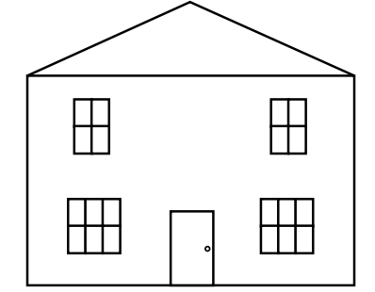
Understanding the House

Slide 17
Summary
understand the principles of library
understand the principles of graphics
get familiar with the graphics library
learn how to use the graphics library
It is not over. At this stage, only still image we can make by the graphics library. To make interactive application, we need more.

Slide 18
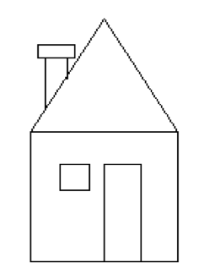
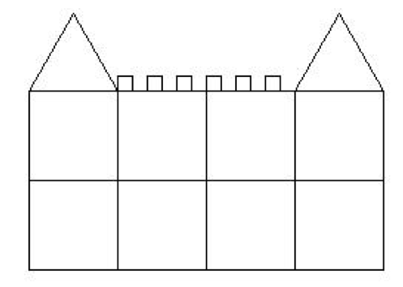
Homework:
画房子，写程序画出下面的房子之一：

Slide 19
Project:
在现有的graphics库的基础上，设计一个新图形绘制系统。
除了已有的笔的概念（有当前位置）之外，再增加一个表示当前角度的全局变量，初始值为0，表示坐标轴的横轴方向（正东）。
然后实现以下两个函数：
void forward(double distance); /*沿当前方向画线，长度为
distance，当distance为负数时后退*/
void turn (double angle); /*顺时针旋转角度angle，角度单位为
DEG，当angle为负数时逆时针旋转*/
void move(double distance); /*沿当前方向移动笔（不画线），长度
为distance，当distance为负数时后退*/
在实现以上全局变量和函数的基础上，用以上函数画出下面的图形：

Slide 20

Project:

Slide 21
The End

